Slide 1
Cloud Networking
Using AWS

Slide 2
Welcome!
Agenda:
Intro
Express Networking Primer
Morning Tea
Basic Network Set Up
Load Balancing
Lunch
Guest Speaker (Jess Fraser)
Photo 📸
Afternoon Tea
Network Testing
Whiteboarding
Wrap-Up

Slide 3
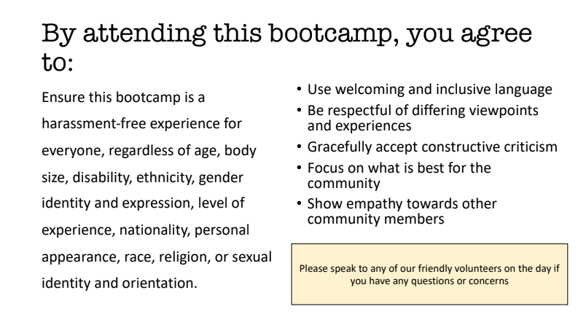
Code of Conduct

Slide 4
Logistics Check List
Toilets
Water/Coffee/Tea
Building Access
Fire Evacuation

Slide 5

Why are you here today?
Let’s discuss in our groups
Image sourced from: https://broadlygenderphotos.vice.com/

Slide 6
Thank you for your sponsorship and providing a location and food

Slide 7
Thank you for your sponsorship and providing AWS account credits

Slide 8






Two Modes of Learning
Theory
We’ll introduce you to some concepts and answer questions
Hands On
We’ll jump into the AWS console and start creating our cloud networks

Slide 9
Intro to AWS Networking Resources
Virtual Private Cloud (VPC)
CIDR Range
Subnets
Internet Gateway (IGW)
NAT Instance
Direct Connect/VPN
VPC Peering
Route Table
Security Groups
Load Balancer
Systems Manager Agent (SSM Agent)
Defines where network traffic can go
Isolated part of the cloud of your AWS services
Connecting VPCs
Connects your VPC to the internet
A managed AWS service that distributes traffic to targets you specify
Securely connect a private subnet to a public subnet
A subset of your VPC
Securely connect your VPC to on-prem infrastructure
Set of rules to block/allow inbound/outbound network traffic
Determines number of IPs your VPC can have
An agent to run a Systems Manager to update, manage, and configure an EC2

Slide 10
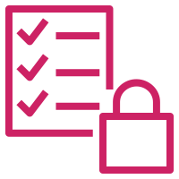


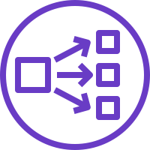
What you will create today
VPC + Subnets
Internet Gateway
Private + Public Route Table
NAT Instance
Security Group
Public Load Balancer
Private Servers
VPC
Private Subnet
Public Subnet
Security Group
Load Balancer
Internet
Web Servers
Public Route Table
NAT
Private Route Table

Slide 11

Networking 101
Digital Copy:
Jvns.ca/networking-zine.pdf
Created by Julia Evans
@b0rk

Slide 12
REFRESHER: Networking OSI Model (Open Systems Interconnection)
7 Application Layer
For human consumption – what we see 👀 eg. HTTP, SNMP, FTP
6 Presentation Layer
Processes data to be used by the app layer, including encryption/decryption, jpg, SSL, TLS
5 Session Layer
4 Transportation Layer (TCP/UDP)
Responsible for transporting packets in a way that covers flow control and reliability
3 Network Layer
Routing data from A to B going across boundaries – IP’s, ICMP, IPsec, IGMP
2 Data Link Layer
How data is linked up from point A to B eg. ARP, MAC Address
1 Physical Layer
Hardware responsible for data transmission – eg the physical cables, hubs, wireless
Creation/Tear down of network connections

Slide 13
IPs and CIDR Ranges
IPs
“Its routing function enables internetworking, and essentially establishes the Internet.”
CIDR
“Classless Inter-Domain Routing (CIDR /ˈsaɪdər, ˈsɪ-/) is a method for allocating IP addresses and IP routing.”

Slide 14
IP’s in more detail…
Basics
An IP address is composed of two parts:
IP addresses contain 4 octets, each consisting of 8 bits giving values between 0 and 255 🤯
The ‘netmask’ designates how many available addresses are in the block – this is number after the /x
The smaller the netmask, the more IP’s that are available
The Network ID: The Network ID represents the first three groups of digits from the IP address. It marks the network the devices are connected to. For example, the IP 193.164.2.35, the network ID is 193.164.2.
The Host ID: The last group of digits from the IP address labels the specific device. In this example 193.164.2.35, the host ID would be 35.

Slide 15
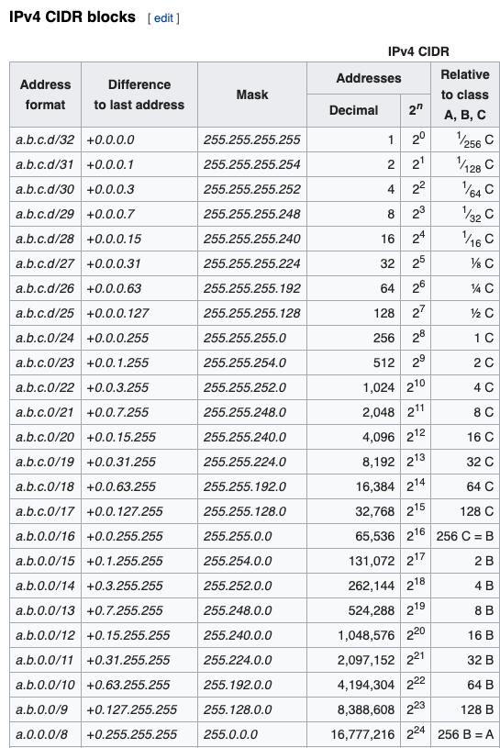
CIDR is principally a bitwise, prefix-based standard for the representation of IP addresses and their routing properties. It facilitates routing by allowing blocks of addresses to be grouped into single routing table entries. These groups, commonly called CIDR blocks, share an initial sequence of bits in the binary representation of their IP addresses.

Slide 16
Subnetting
“A subnetwork or subnet is a logical subdivision of an IP network. The practice of dividing a network into two or more networks is called subnetting.”
Check out cidr.xyz for a visual representation of this!

Slide 17
Let’s Try It Out…
Task
Your VPC’s Private IP is 10.0.0.0/16
How many IP’s are available?
What’s the first and last IP of this CIDR range?
How many IP’s are available if you change the netmask to /24

Slide 18
IP’s in your Cloud Network
10.0.0.0/16
VPC
Private Subnet
Public Subnet
Security Group
10.0.1.X
10.0.2.X
Load Balancer
Internet
Web Servers
Public IP
Public Route Table
NAT
Private Route Table
10.0.1.0/24
10.0.2.0/24

Slide 19
AWS and IP’s
/x is the size of the bytes
VPCs - between /16 and /8
Subnets - between /16 and /28 (CIDR blocks of the subnets cannot overlap)
AWS’s 5 reserved IPs:
Network address
VPC Router
DNS Server
‘future use’
Network Broadcast address
Subnet CIDR range cannot be the same or larger than the VPC

Slide 20
Morning Tea!
See you in 15 mins

Slide 21
Let’s Briefly Talk About ‘High Availability’

